Slide 1
Effort Certification & BOT Process (Workday)

Slide 2
Effort Certification: KFS – Workday
Task/Report | KFS Past Process | Workday Future Process
Effort Certification Dashboard | KFS Dashboard | Workday Dashboard (& Homepage Widget to redirect)
Role Assignments | Time consuming at employee level | Inherited based on your role
Role Types | Reviewer, Preparer, Certifier | Reviewer/Certifier
14-Day Notice | Simple email notification | Email from OFA, ability to use Pro Forma report, ability to prepare effort document before official 30 day open period
7-Day Notice | Simple email notification | Email from OFA, ability to use Pro Forma report, ability to prepare effort document before official 30 day open period
OPENING PERIOD
Open PET/PAA before at Opening | All cancelled | All cancelled
System Generated email | Everyone receives at once | All prepared documents from prior (i.e. 14- day/7-day periods) will move forward to Certifiers. All others must be completed first before moving to certifier.
Certification percentages | Summary by Account | Summary only at Grant Level. Aggregate at PPGG level (pending)
Changes to percentages | Aggregate by Effort Period | Aggregate by Payroll Period (Monthly). Additionally by Earn Line. PPGG follows driver worktag process.

Slide 3
Effort Certification: KFS – Workday (cont.)
Task/Report | KFS Past Process | Workday Future Process
OPENING PERIOD
BOT Process | Did not exist | Developed in order to accommodate complexity of Monthly/Earn. line changes in effort.
Recreation of eDocs | Simple 1-click, unlimited during period | Must contact OFA to recreate
Salary Cap | System generated cap percentage | Now driven by Payroll Allocation at set-up. Changes to effort need to follow proper ratio.
Terminated Employees | All handled via manual process | Term Faculty, no change. Term Staff, will reroute to the PI based on Grant(s)
Split RAs | Both PI's certify their portion | Both PI's certify, however, coordination needs to happen between departments.
Mass Certification | Yes | Yes, separate process within Dashboard
OTHER
PAAs after certification period. | Blocked unless OFA provides override | ALL PAAs will route to OFA for decision.
Labor Distribution Data |  | Use the Labor Distribution Detail / Payroll Register report to view posted result lines. Tip: Posted PAAs are visible if the ‘Adds to Gross’ pay component option is cleared.

Slide 4
Effort Certification Workday Roles
Effort Certification Manager: OFA
Highest: Andres Chan, Director of OFA
Effort Certification Reviewer: Department roles, Sr Admin
Highest: Ben Bell, Compliance
Principal Investigator (Grant): Faculty who certify for themselves and their support(post docs, graduate assistants).
Highest: N/A - Varies by Grant/Award
Employee as Self: Postdoc Employees or exempt staff
Highest: N/A - Varies by Grant/Award

Slide 5
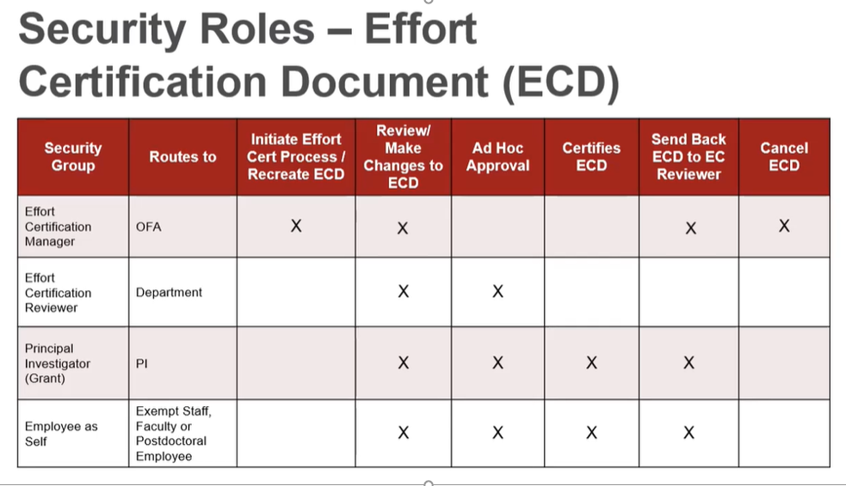

Slide 6
Sample Scenarios
View Pro Forma Report
Worker Name: Faculty Pro Forma
View E-cert Dashboard & Mass Certification Process
Active Faculty, Post Doc, or Staff Employee (standard)
Worker Name: Faculty Viterbi
Grant Added: GR1003318
Terminated Staff Employee
Worker Name: Staff Term Viterbi
Grant Added: GR1016857
Overview of BOT Process

Slide 7
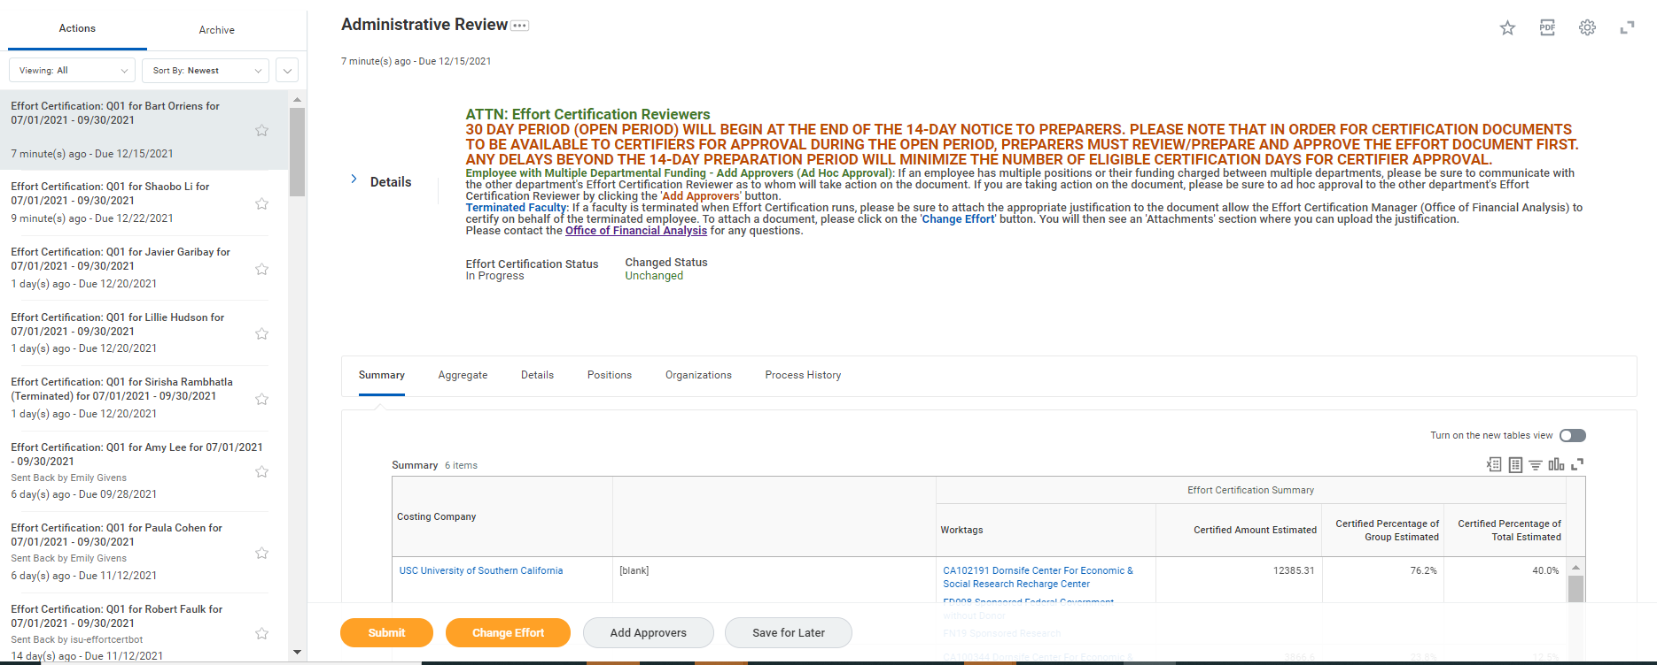
Click on Effort Cert notification to open up summary of effort doc

Slide 8
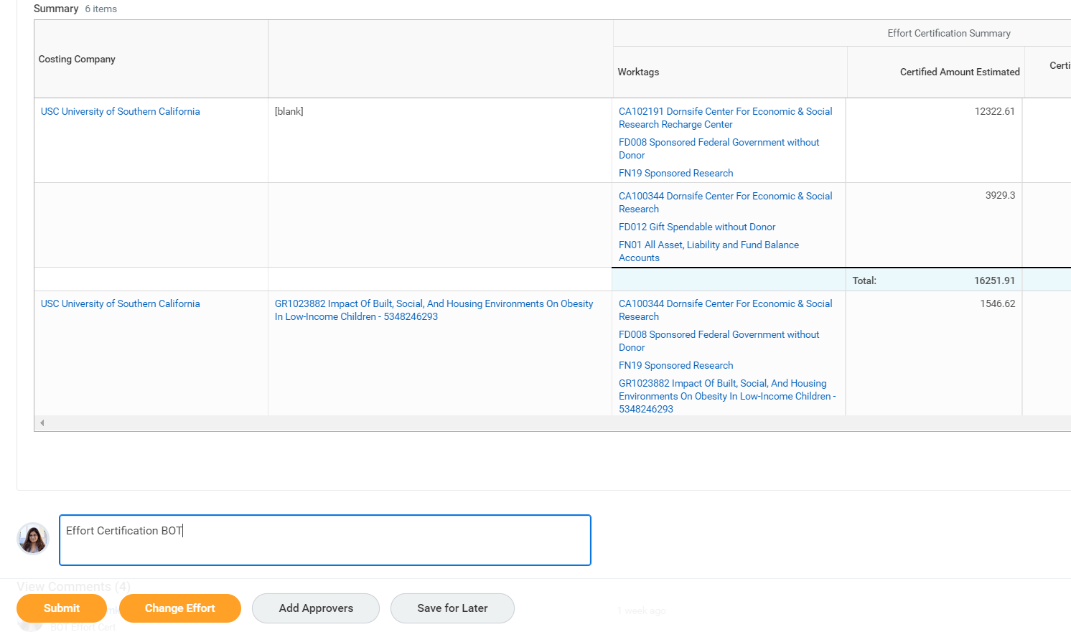
1st step – Enter executable comment “Effort Certification BOT”
2nd Step – click “Submit” button to launch ‘to-do’ for worksheet report

Slide 9
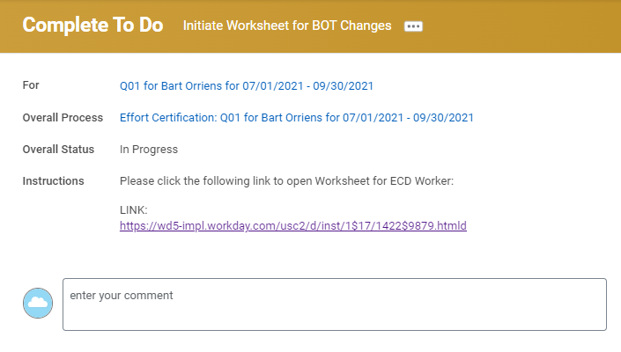
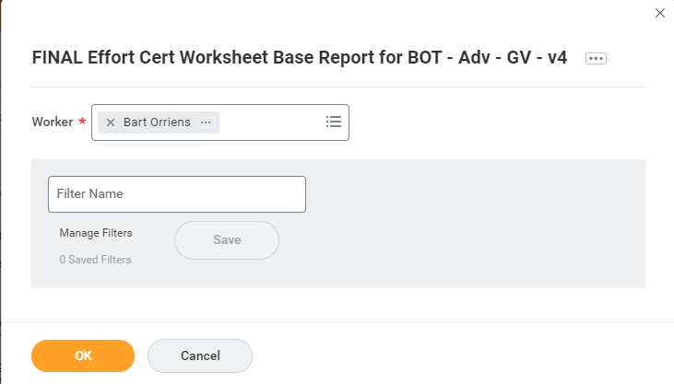
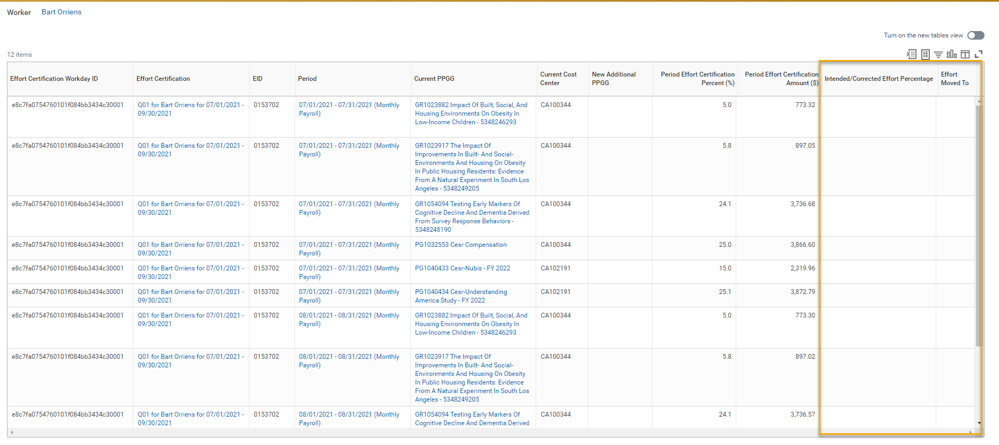
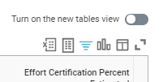
3rd step – click link to report in ‘to-do’ step and enter worker details in prompt
4th step – Confirm correct worker in report and click icon to launch Worksheet

Slide 10
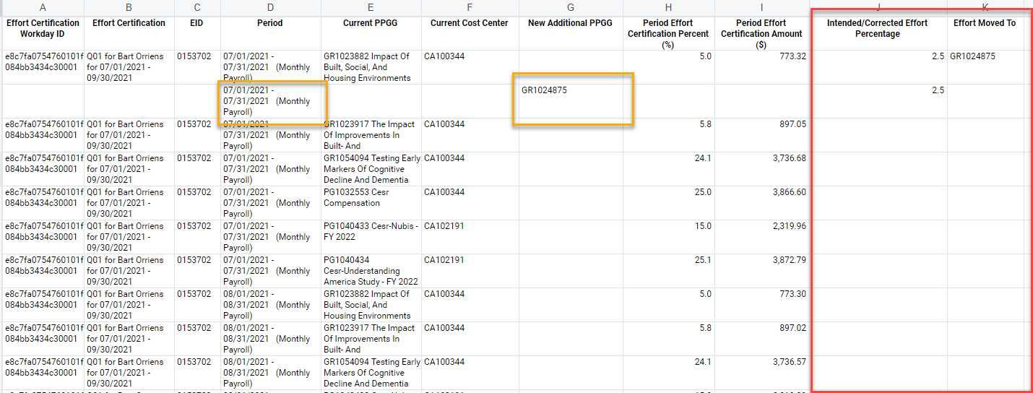
Adding Grant Account
5th step – Enter intended/corrected effort for PPPG, by period, and indicate ‘To’ grant on the ‘From’ account

Slide 11
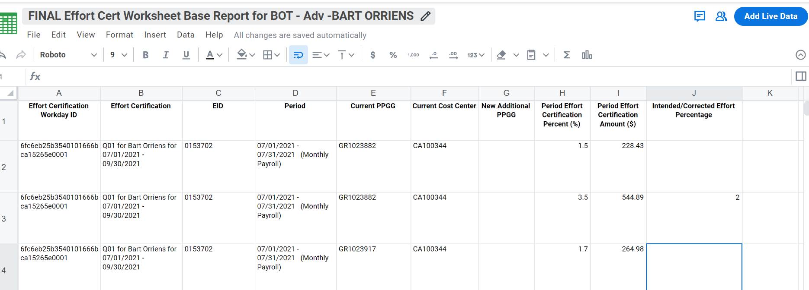
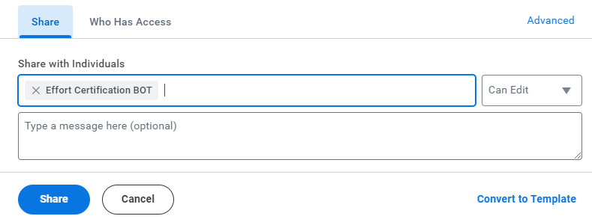
Sharing w BOT
6th Step – Select share icon and share with BOT

Slide 12
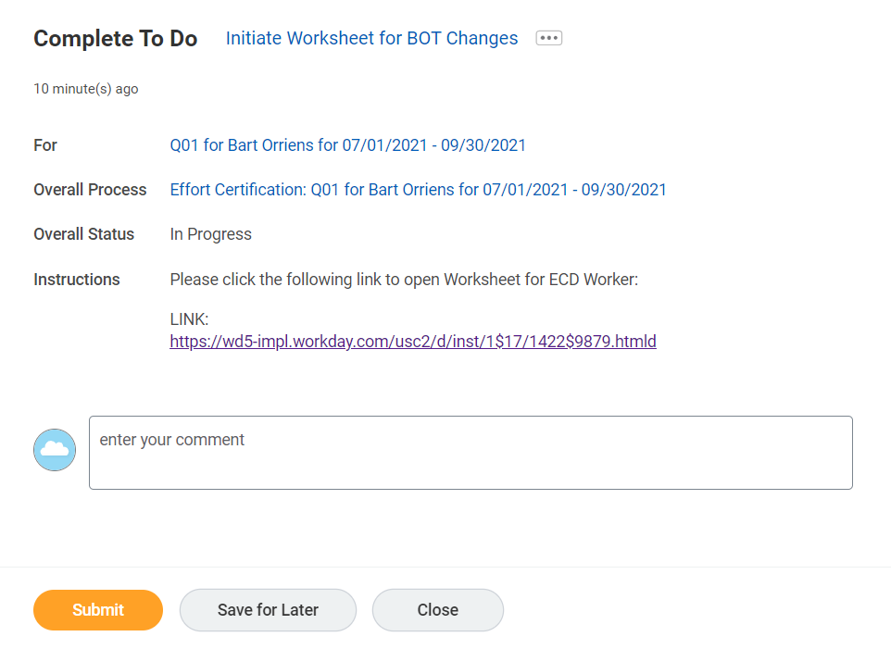
Sharing w BOT: OPTION A
7th Step – return to to-do and enter ‘Effort Certification Bot’ comment, again.
IMPORTANT: If this comment is not entered here a second time, the ECD will not route to the BOT and will instead move to the certification step with an unchanged ECD
8th Step –submit as completed.

Slide 13
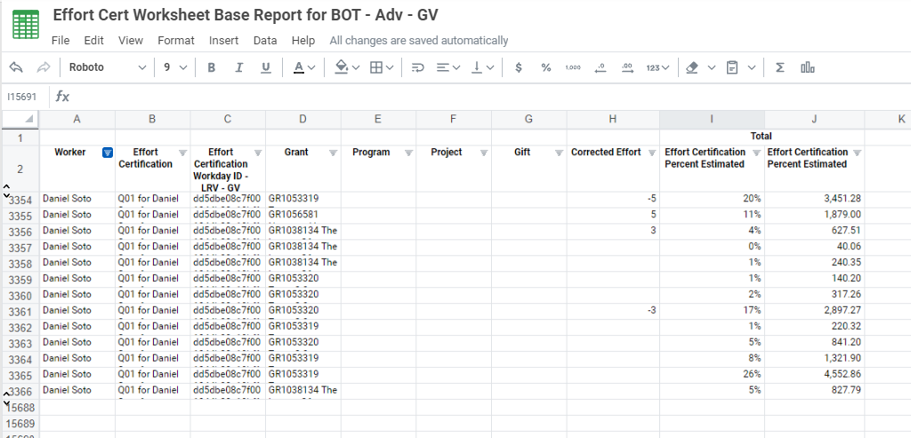
Changed
Effort
Workday
Effort ID
Ensure that new “ROWS” can be added should it be necessary.
BOT will be triggered by To-Do step submission and the ECD coming into it’s inbox.
BOT will access worksheet
Option A – through Drive directly
Option B – through link to Worksheet submitted in ‘To Do’ comment.
BOT will use the Workday Effort Cert. ID to be able to access the workday individual’s monthly pay components
BOT will be using information from ‘Corrected Effort’ column to identify delta from original (assuming using subtotal rather
by month to month basis, subject to discussion on ease/complexity)
BOT will use delta and apply the changes to a prorated value based on detail payroll information (from Change Effort Screen)
BOT will then launch “Change Effort” button
BOT will apply final figures to sheet as well as apply reason code.

Slide 14
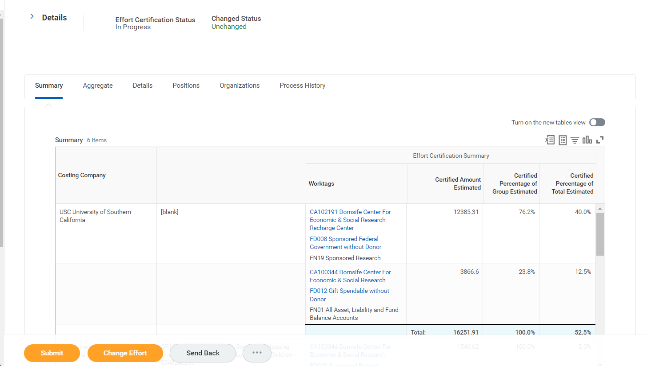
Upon BOT finalizing figures, it would trigger the “Change Effort” button to enable where final results are to be included

Slide 15
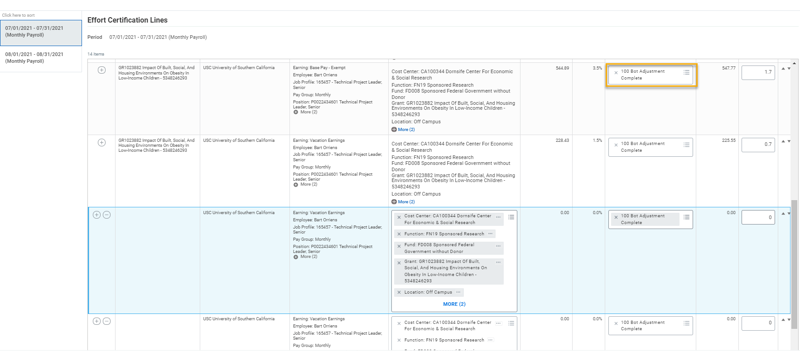
* 99 – Ready for Bot will no longer required
BOT to update “Change Reason” to “100 Bot Adjustment Complete
as well as “Certified Percent Estimated” based on
BOT results from Worksheet. The BOT will then submit the ECD.

Slide 16
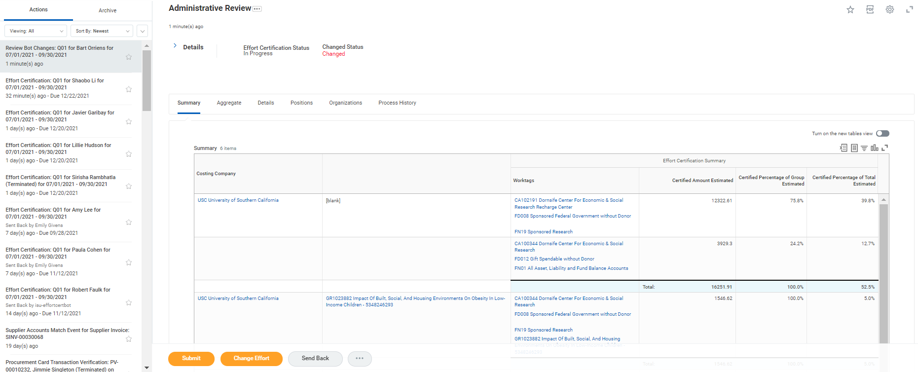
Upon BOT submission of changes, the ECD returns to the EC Reviewer for administrative review. Once submitted at this point, it routes to the certifier.

Slide 17
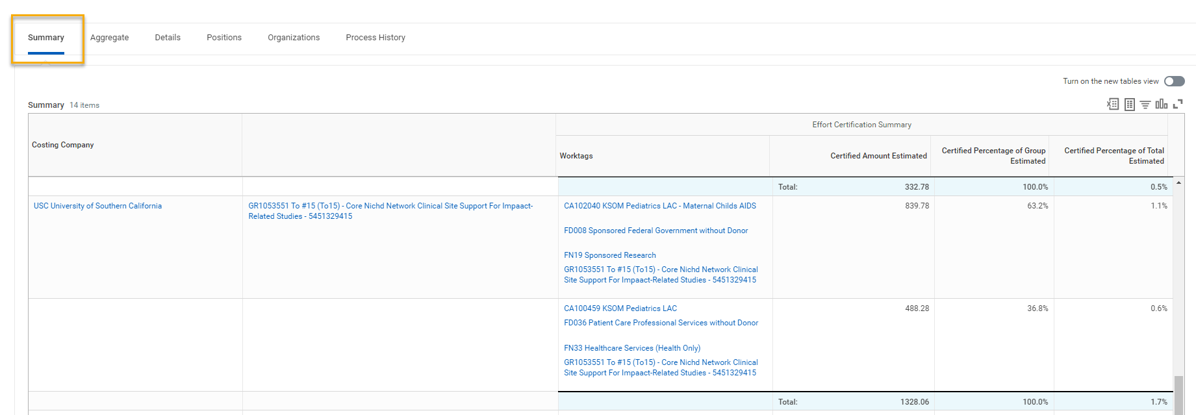
Effort Certification: Salary Over Cap in ECD

Slide 18
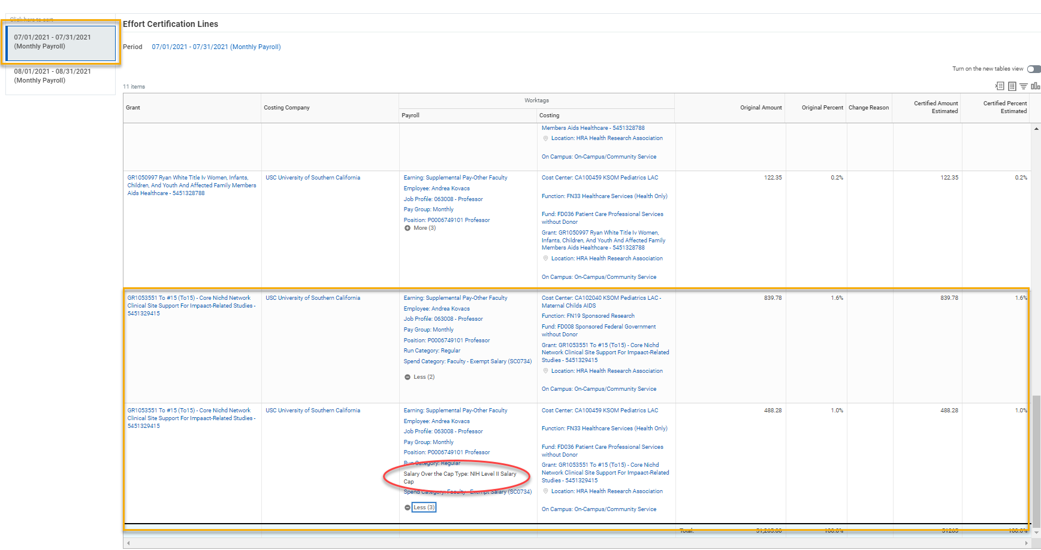
Effort Certification: Salary Over Cap in ECD

Slide 19
Training References
Effort Certification Reviewers:
See Effort Certification for Effort Certification Reviewers QRG on the Workday Hub: Link
Search for and complete the training titled "Workday Finance: Effort Certification for Effort Certification Reviewers" on TrojanLearn: Link to TrojanLearn
Principal Investigators:
See Effort Certification for Principal Investigators QRG on the Workday Hub: Link
Search for and complete the training titled "Workday Finance: Grants Management for Principal Investigators"* on TrojanLearn: Link to TrojanLearn
*Note this course is for general grants management, with a section on effort certification activities.

Slide 20
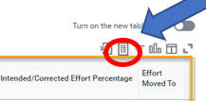
Effort Certification Bot Submission Procedures
Select effort certification document
Via inbox task or through the ‘review’ button when viewing ECD in reports.
Navigate to Aggregate/Detail tabs to determine that based on the complexity of the information (too many earning elements per grant) that you may want to use the BOT feature.
If No, proceed as usual with making changes directly into the effort document
If Yes, the proceed with the BOT process
BOT Process:
Navigate to Comment Box at the bottom of effort document
Enter the following text in the comment box:
“Effort Certification BOT”
Click Submit
A “Complete To Do” inbox task will appear with a link to the Workday Worksheet base report.
Click the link and the report prompt will appear
Enter the employee name with in the “worker” area
Click ok
You will now see the BOT Worksheet spreadsheet
Next step is to convert it to a worksheet that will enable editing in the document
To do this click on the icon for the worksheet
You are now able to edit within the document

Slide 21
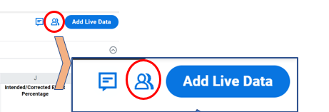
Effort Certification Bot Submission Procedures
With Existing PPGGs
Make changes to effort:
If there is a need to add new PPGGs, please see next slide for additional information
Percentage entries can use up to 1 decimal point (i.e. 7.5). No percentage sign is to be included in the box.
Use columns “Intended/Corrected Effort Percentage” and ‘Effort Moved To’
Enter intended percentage for the PPGG on the “From” side and
Enter intended percentage for the PPGG on the “To” side
The NET variances should ZERO out as they are moving from PPGG(s) to other PPGG(s)
Document auto-saves
To share document with BOT, click on share icon

Slide 22
Effort Certification Bot Submission Procedures
When Adding New PPGGs
Adding New PPGGs
Similar to excel, simply enter a row(s) for the periods you will be adding a new PPGG
The following MUST be included within the new PPGG line:
Period – The month in which the change is occurring
New Additional PPGG – add the new PPGG not previously part of the ecd
Intended/Corrected Percentage – enter the percentage to be certified
Effort Moved To - The PPGG which the BOT will be using to copy the appropriate earn types in order to perform the calculation

Slide 23
Effort Certification Bot Submission Procedures
A box will appear
In the box section “Share with Individuals” enter the BOT name again:
Type “Effort Certification BOT”
Click Share button
Return to the inbox To Do task
Enter comment “Effort Certification BOT”
Click submit
Process is now complete and the ECD is now in the BOT queue

